Slide 1
Database Project - Kiptush
MD. OLIUR RAHMAN -12101120
TAJUL ISLAM - 12101067
ABU SUFIAN - 12101048
SYEDA NOORJAHA AZIM - 12101064

Slide 2
Project Idea
Build a mobile application to track each individuals expenditure, income and budget for each category.
As an admin of the application, run some analysis to check specific field wise expenditure, budget and income.

Slide 3
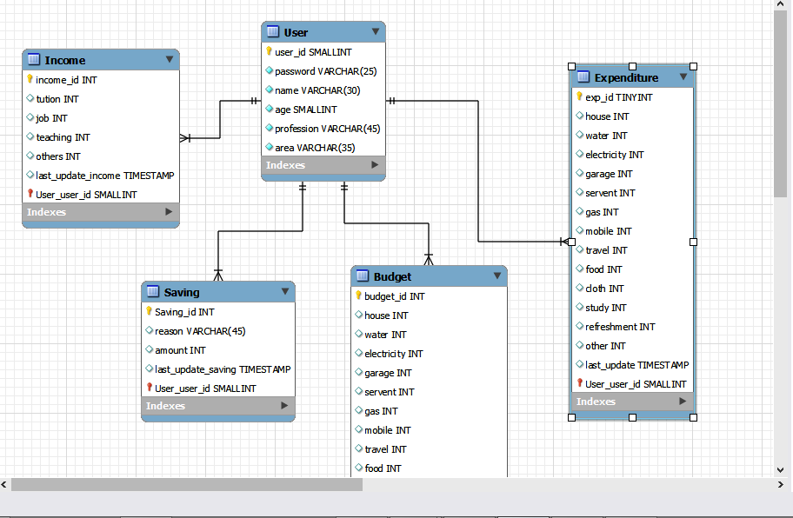
Screen Shot of ER Diagram

Slide 4
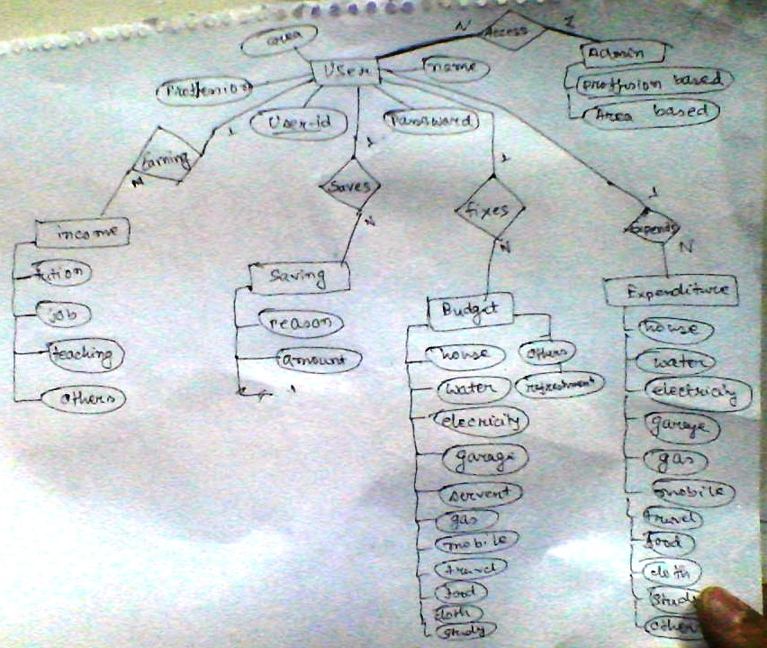
ER Diagram

Slide 5
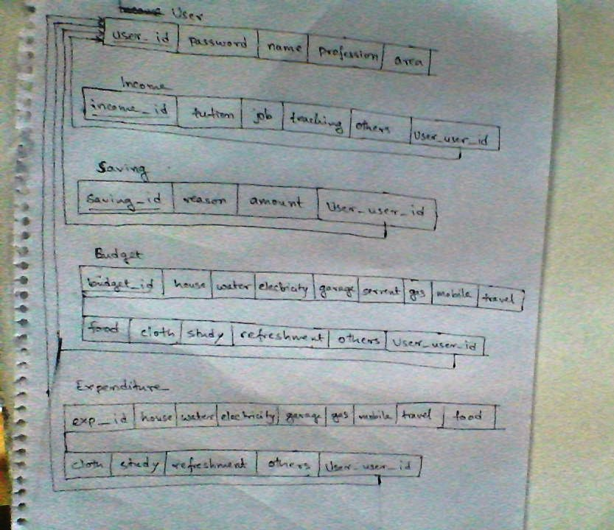
Schema

Slide 6
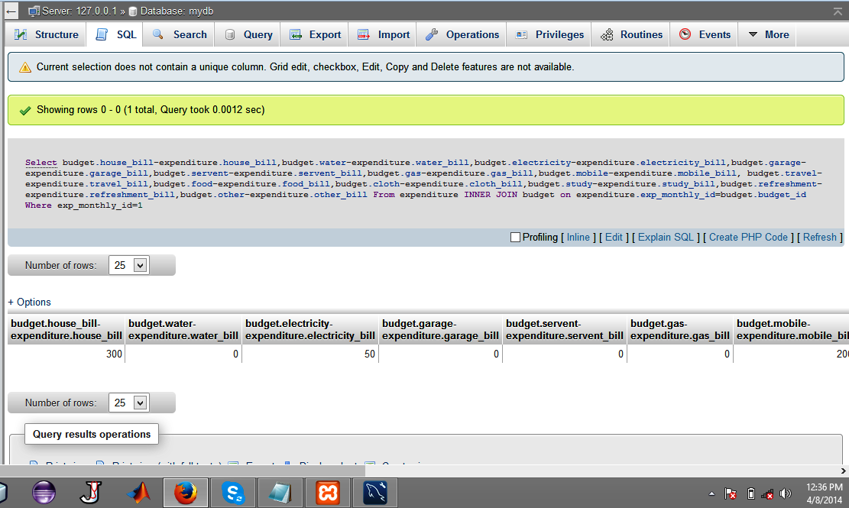
Screen Shot of backend Database query

Slide 7
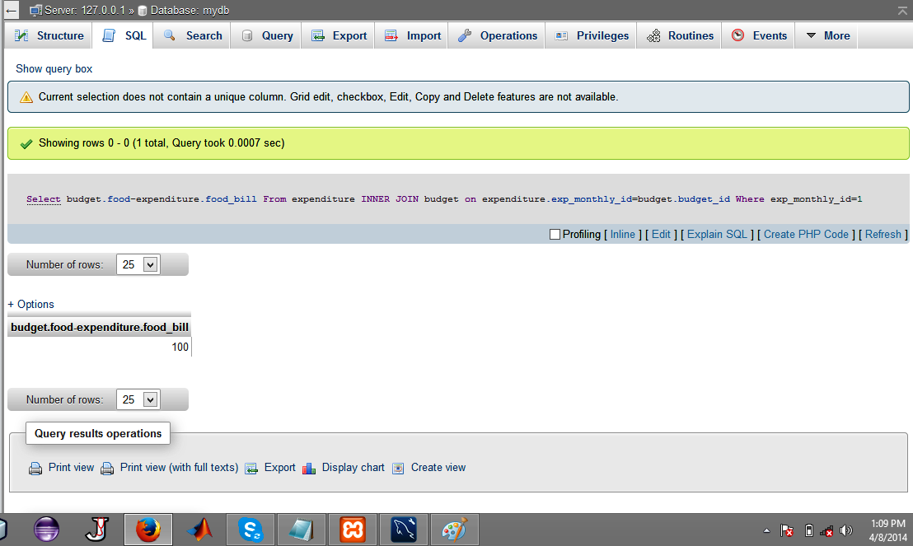
Screen Shot of backend Database query

Slide 8
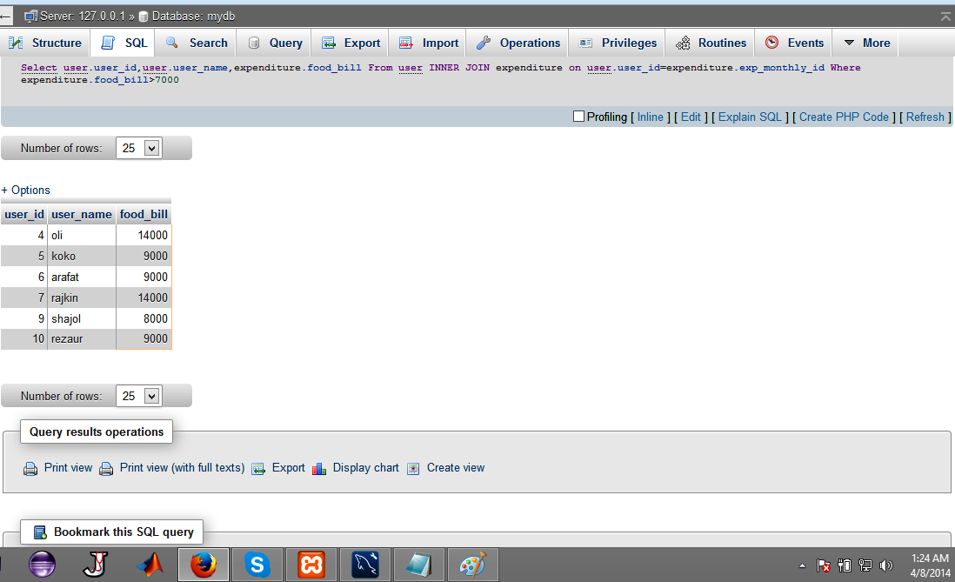
Screen Shot of backend Database query

Slide 9
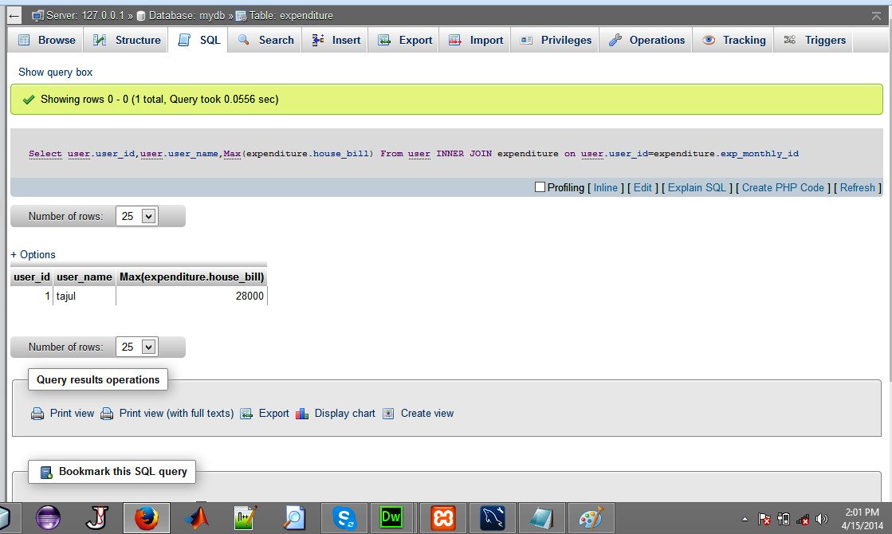
Screen Shot of backend Database query

Slide 10
Thank You

